Slide 1
Fredericksburg Regional Alliance at the University of Mary Washington
Annual Meeting Presentation
Presented By Curry Roberts , President
11/10/2016

Slide 2
Website Sessions FY 2014- FY2017
Eastern Virginia’s Fourth Metropolitan Area

Slide 3
TOTAL PROJECTS FY 2015 - FY 2017
Eastern Virginia’s Fourth Metropolitan Area

Slide 4
Projects Industry FY 2015 vs 2016
Eastern Virginia’s Fourth Metropolitan Area

Slide 5
Projects Industry FY 2015 vs 2016
Eastern Virginia’s Fourth Metropolitan Area

Slide 6
FRA Direct Projects
44
7
9
Eastern Virginia’s Fourth Metropolitan Area

Slide 7
FY Capital Investment and Jobs
FY 2015
$127,500,000
FY 2016
$200,000,000
FY 2017 (Projected)
$93,000,000
250 Jobs
400 Jobs
304 Jobs
Eastern Virginia’s Fourth Metropolitan Area

Slide 8
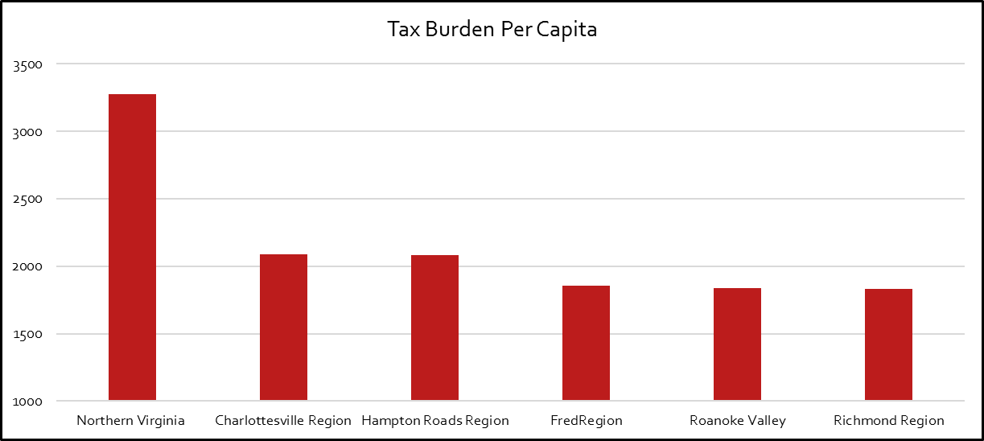
Tax Comparison
Source: Fiscal Analytics Ltd.
Eastern Virginia’s Fourth Metropolitan Area

Slide 9
University of Mary Washington’s Center for Business Research
In addition to the Commuter Skills Study (2016), the Center will also study the following topics over the next two years:
The region’s cybersecurity landscape
The cost of traffic congestion to the region’s governments and businesses
How much the region’s job growth can be attributed to unique regional versus national factors (Shift Share)
The regional economic impact of the Dahlgren and Indian Head naval bases
Partnership with:
UMW’s College of Business
Fredericksburg Regional Chamber of Commerce
Fredericksburg Regional Alliance
Eastern Virginia’s Fourth Metropolitan Area

Slide 10
Strengthening Regional Capacity
Site Readiness
City of Fredericksburg
UMW / Stafford County
King George County
Hylton Property - 70 acres
RT 17 Stafford East – 227 acres
Taylor Property – 300 acres
Spotsylvania / Caroline Counties
Orrock Assemblage – 1100 acres
Recently received $5,000 grant from VEDP
Eastern Virginia’s Fourth Metropolitan Area

Slide 11
Marketing Calendar
Eastern Virginia’s Fourth Metropolitan Area

Slide 12
Thank you!
Twitter - @Fredregion
Facebook- Fredregion
Eastern Virginia’s Fourth Metropolitan Area

